Slide 1


Data Visualization
Sheetal Pereira
Assistant Professor
Department of Computer Engineering
K. J. Somaiya College of Engineering
Somaiya Vidyavihar University
Notes:
https://paldhous.github.io/ucb/2016/dataviz/week2.html

Slide 2
Using color effectively
Color falls low on the perceptual hierarchy of visual cues, Still deployed to highlight particular elements of a chart, and sometimes to encode data values.
Poor choice of color schemes is a problem that bedevils many news graphics, so it is worth taking some time to consider how to use color to maximum effect.
It helps to think about colors in terms of the color wheel, which places colors that “harmonize” well together side by side, and arranges those that have strong visual contrast — blue and orange, for instance — at opposite sides of the circle:

Slide 3
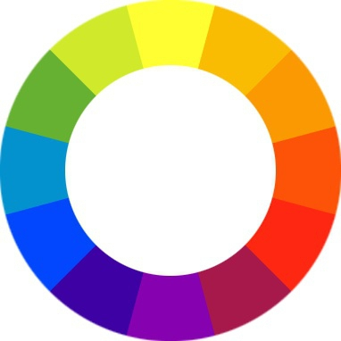
(Source: Wikimedia Commons)

Slide 4
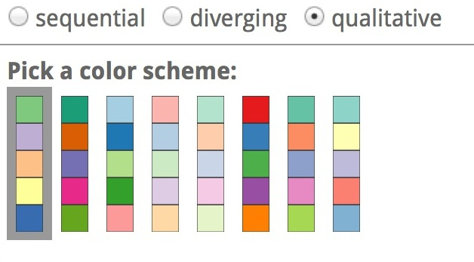
When encoding data with color, take care to fit the color scheme to your data, and the story you’re aiming to tell.
Color is often used to encode the values of categorical data.
Here you want to use “qualitative” color schemes, where the aim is to pick colors that will be maximally distinctive, as widely spread around the color wheel as possible:
(Source: ColorBrewer)

Slide 5
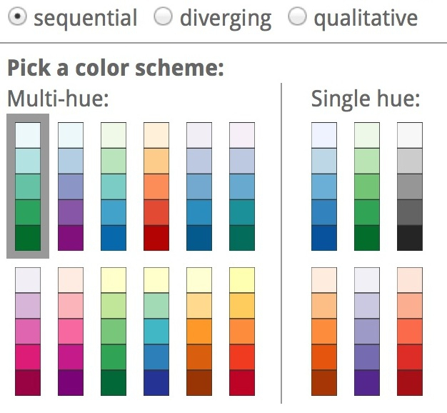
When using color to encode continuous data, it usually makes sense to use increasing intensity, or saturation of color to indicate larger values.
These are called “sequential” color schemes:
(Source: ColorBrewer)

Slide 6
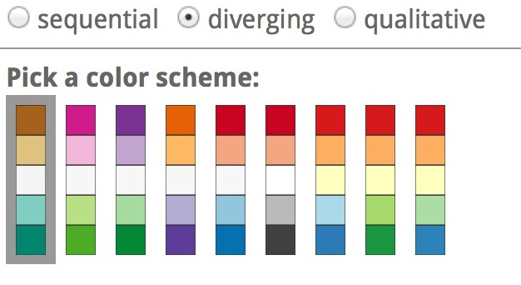
In some circumstances, you may have data that has positive and negative values, or which highlights deviation from a central value.
Here, you should use a “diverging” color scheme, which will usually have two colors reasonably well separated on the color wheel as its end points, and cycle through a neutral color in the middle:
(Source: ColorBrewer)

Slide 7
Choosing color schemes is a complex science and art
Many visualization tools include suggested color palettes
ColorBrewer, Orginally designed for maps, but useful for charts in general, these color schemes have been rigorously tested to be maximally informative.

Slide 8
It suggests can be displayed according to their values on three color “models”: HEX, RGB and CMYK.
RGB Three values, describing a color in terms of combinations of red, green, and blue light, with each scale ranging from 0 to 255; sometimes extended to RGB(A), where A is alpha, which encodes transparency. Example: rgb(169, 104, 54).
HEX A six-figure “hexadecimal” encoding of RGB values, with each scale ranging from hex 00 (equivalent to 0) to hex ff (equivalent to 255); HEX values will be familiar if you have any experience with web design, as they are commonly used to denote color in HTML and CSS. Example: #a96836
CMYK Four values, describing a color in combinations of cyan, magenta, yellow and black, relevant to the combination of print inks. Example: cmyk(0, 0.385, 0.68, 0.337)
HSL Three values, describing a color in terms of hue, saturation and lightness (running from black, through the color in question, to white). Hue is the position on a blended version of the color wheel in degrees around the circle ranging from 0 to 360, where 0 is red. Saturation and lightness are given as percentages. Example: hsl(26.1, 51.6%, 43.7%)
HSV/B Similar to HSL, except that brightness (sometimes called value) replaces lightness, running from black to the color in question. hsv(26.1, 68.07%, 66.25%)
Colorizer is one of several web apps for picking colors and converting values from one model to another.

Slide 9
Custom color schemes can also work well, but experiment to see how different colors influence your story.
The following graphic from The Wall Street Journal, for instance, uses an unusual pseudo-diverging scheme to encode data — the US unemployment rate — that would typically be represented using a sequential color scheme.
It has the effect of strongly highlighting periods where the jobless rate rises to around 10%, which flow like rivers of blood through the graphic.

Slide 10
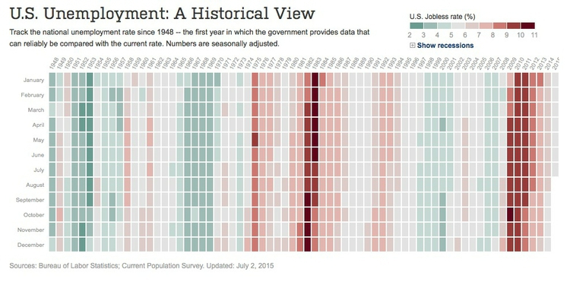
(Source: The Wall Street Journal)
Notes:
If you intend to roll your own color scheme, try experimenting with I want hue for qualitative color schemes, the Chroma.js Color Scale Helper for sequential schemes, and this color ramp generator, in combination with Colorizer or another online color picker, for diverging schemes.
You will also notice that ColorBrewer allows you to select color schemes that are colorblind safe. Surprisingly, many news organizations persist in using color schemes that exclude a substantial minority of their audience. Red and green lie on opposite sides of the color wheel, and also can be used to suggest “good” or “go,” versus “bad” or “stop.” But about 5% of men have red-green colorblindness, also known as deuteranopia. Here, for example, is what the budget treemap from The New York Times would look like to someone with this condition:

Slide 11
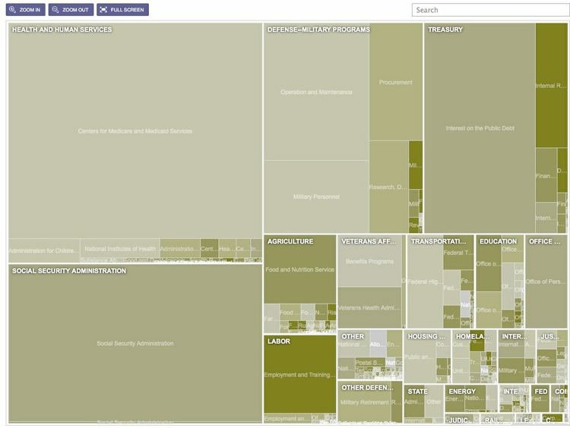

Slide 12
Using chart furniture, minimizing chart junk, highlighting the story
Title and subtitle These provide context for the chart.
Coordinate system For most charts, this is provided by the horizontal and vertical axes, giving a cartesian system defined by X and Y coordinates; for a pie chart it is provided by angles around a circle, called a polar coordinate system.
Scale Labeled tick marks and grid lines can help your audience read data values.
Labels : Label each axis. Other labels that may be necessary to explain the message of graphic.
Legend: Color or shape to encode data, then legends are needed to explain encoding.
Source information Usually given as a footnote. Don’t forget this!

Slide 13
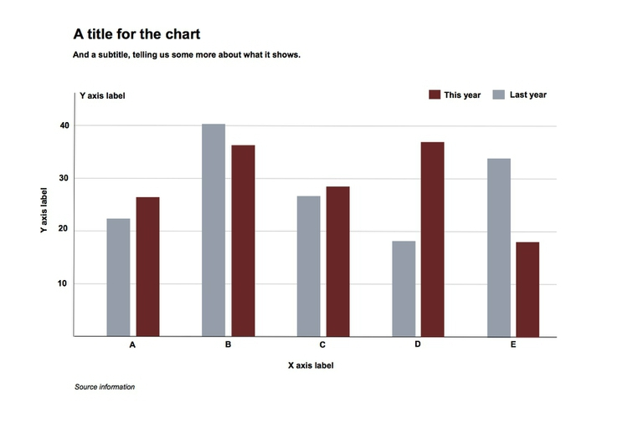

Slide 14
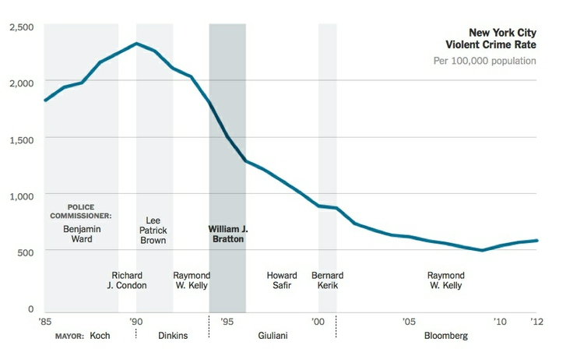
Chart furniture can also be used to encode data, as in this example, which shows the terms of New York City’s police commissioners and mayors with reference to the time scale on the X axis:
(Source: The New York Times)
Notes:
In this example, the label for the Y axis is displayed horizonatally in the main chart area, rather than vertically alongside the chart. News media often do this so that readers don’t have to crane their necks to read the label. If you do this, check that it is clear to users that the label refers to scale on the Y axis.
Think carefully about how much chart furniture you really need, and make sure that the story told by your data is front and center. Think data-ink: What proportion the ink or pixels in your chart is actually encoding data, and what proportion is embellishment, adding little to your story?

Slide 15
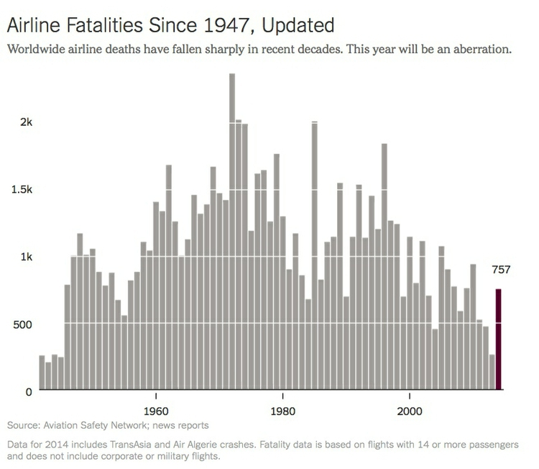
Here is a nice example of a graphic that minimizes chart junk, and maximizes data-ink. Notice how the Y axis doesn’t need to be drawn, and the gridlines are an absence of ink, consisting of white lines passing through the columns:
(Source: The Upshot, The New York Times)
Notes:
Contrast this with the proliferation of chart junk in the earlier misleading Fox News column chart.
Labels and spot-color highlights can be particularly useful to highlight your story, as shown in the following scatter plots, used here to show the relationship between the median salaries paid to women and men for the same jobs in 2015. In this case there is no suggestion of causation; here the scatter plot format is being used to display two distributions simultaneously — see the chart types thought-starter.

Slide 16
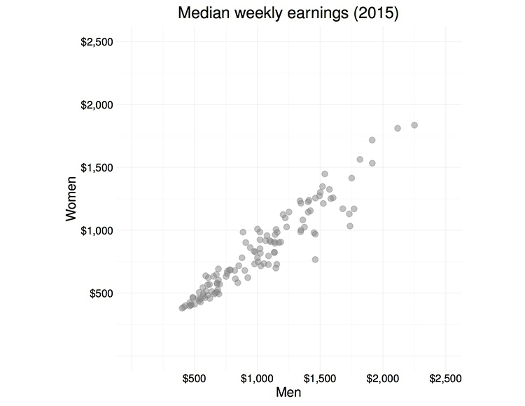
(Source: Peter Aldhous, from Bureau of Labor Statistics data)
Notes:
It is clear from the first, unlabeled plot, that male and female salaries for the same job are strongly correlated, as we would expect, but that relationship is not very interesting. Notice also how I have used transparency to help distinguish overlapping individual points.

Slide 17
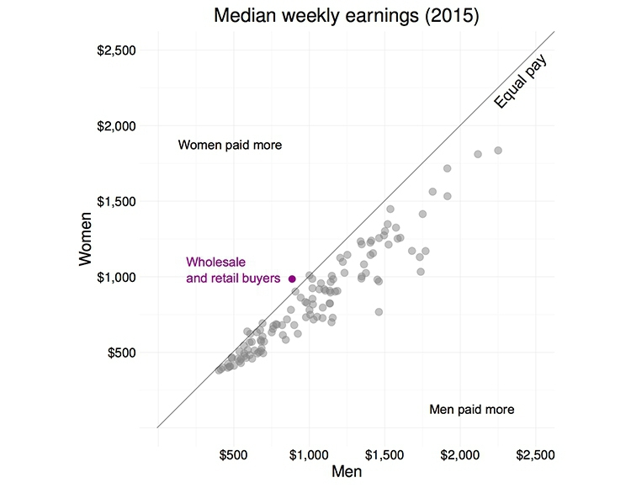
(Source: Peter Aldhous, from Bureau of Labor Statistics data)
Notes:
What we are interested in here is whether men and women are compensated similarly for doing the same jobs. The story in the data starts to emerge if you add a line of equal pay, with a slope of 1 (note that this isn’t a trend line, as we discussed last week). Here I have also highlighted the few jobs in which women in 2013 enjoyed a marginal pay gap over men:

Slide 18
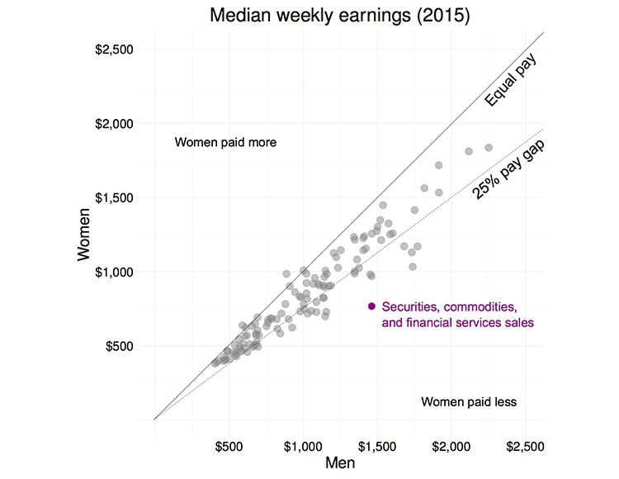
(Source: Peter Aldhous, from Bureau of Labor Statistics data)
Notes:
Notice how adding another line, representing a 25% pay gap, and highlighting the jobs where the pay gap between men and women is largest, emphasizes different aspects of the story:

Slide 19
Pitfalls to avoid
If you ever decide to encode data using area, be sure to do so correctly.
If one unit is a square with sides of length one, then the correct way to represent a value of four is a square with sides of length two (2*2 = 4), not a square with sides of length four (4*4 = 16).
Mistakes are frequently made, however, when encoding data by the area of circles.
In 2011, for instance, President Barack Obama’s State of the Union Address for the first time included an “enhanced” online version with supporting data visualizations.
This included the following chart, comparing US Gross Domestic Product to that of competing nations:

Slide 20
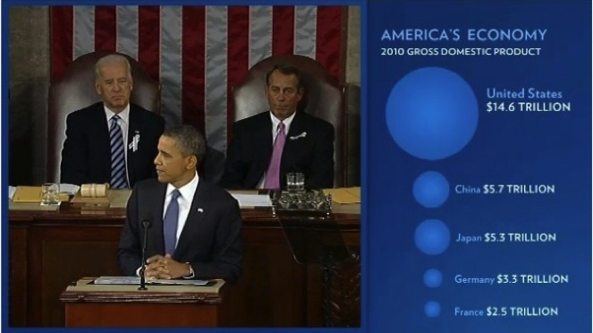
(Source: The 2011 State of the Union Address: Enhanced Version)

Slide 21
Data-savvy bloggers were quick to point out that the data had been scaled by the radius of each circle, not its area. Because area = π * radius^2, you need to scale the circles by the square root of the radius to achieve the correct result, on the right:

Slide 22
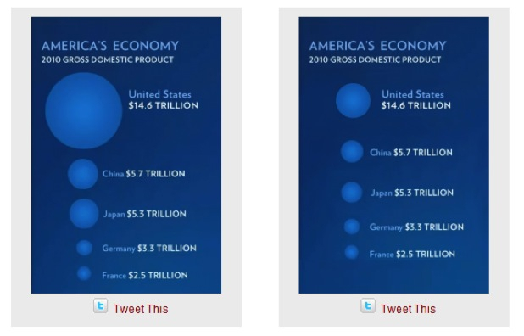
(Source: Fast Fedora blog)

Slide 23
Many software packages (Microsoft Excel is a notable culprit) allow users to create charts with 3-D effects.
Some graphic designers produce customized charts with similar aesthetics.
The problem is that that it is very hard to read the data values from 3-D representations, as this example illustrates:

Slide 24
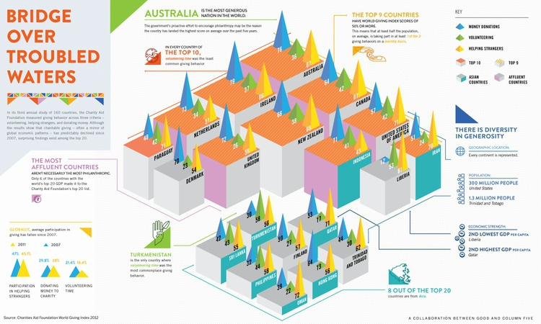
(Source: Good)

Slide 25
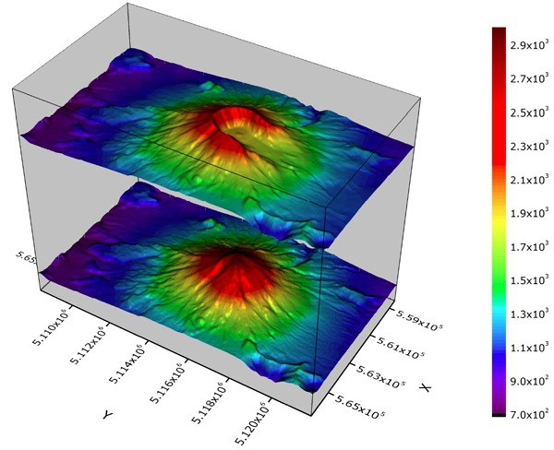
A good rule of thumb for data visualization is that trying to represent three dimensions on a two dimensional printed or web page is almost always one dimension too many, except in unusual circumstances, such as these representations of Mount St. Helens in Washington State, before and after its 1980 eruption:
(Source: OriginLab)

Slide 26
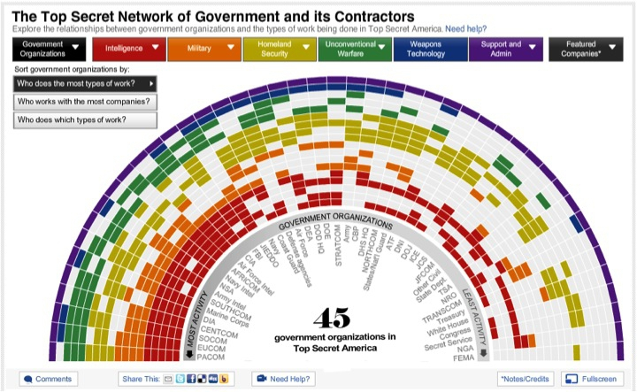
Sometimes even leading media outlets lose their way. See if you can make sense of this interactive graphic on clandestine US government agencies and their contractors:
(Source: The Washington Post)
Notes:
Above all, aim for clarity and simplicity in your chart design. Clarity should trump simplicity. As Albert Einstein is reputed to have said: “Everything should be made as simple as possible, but not simpler.”

Slide 27
Be true to the ‘feel’ of the data
Think about what the data represents in the real world, and use chart forms, visual encodings and color schemes that allow the audience’s senses to get close to what the data means — note again the “rivers of blood” running through The Wall Street Journal’s unemployment chart, which suggest human suffering.

Slide 28
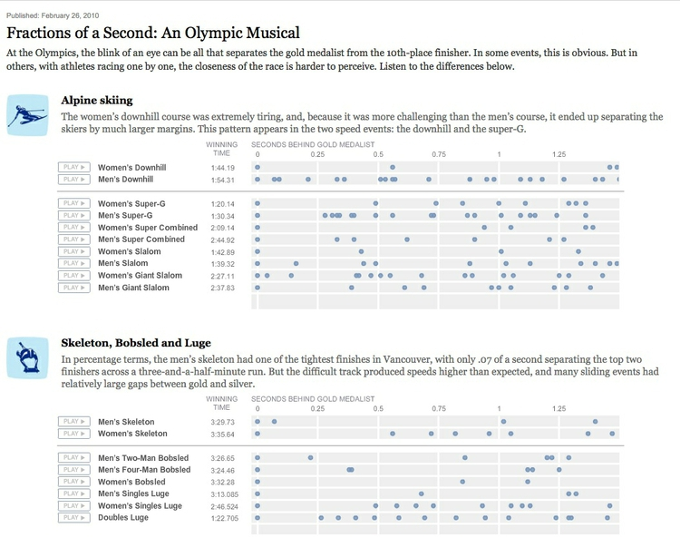
(Source: The New York Times)
Notes:
The best example I know of this uses sound rather than visual cues, so strictly speaking it is “sonification” rather than visualization. In 2010, this interactive from The New York Times explored the narrow margins separating medalists from also-rans in many events at the Vancouver Winter Olympics. It visualized the results in a conventional way, but also included sound files encoding the race timings with musical notes.
Our brains process music in time, but perceive charts in space. That’s why the auditory component of this interactive was the key to its success.

Slide 29
Break the story down into scenes
Many stories have a step-by-step narrative, and different charts may tell different parts of the story. So think about communicating such stories through a series of graphics. This is another good reason to experiment with different chart types when exploring a new dataset. Here is a nice example of this approach, examining demographic change in Brazil:

Slide 30
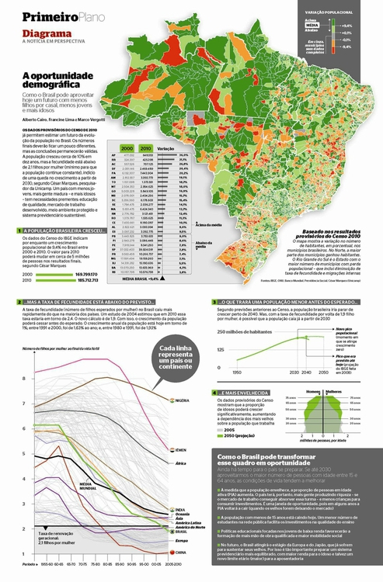
(Source: Época, via Visualopolis)

Slide 31
Good practice for interactives
Nowadays the primary publication medium for many news graphics is the web or apps on mobile platforms, rather than print, which opens up many possibilities for interactivity.
Greatly enhances ability to tell a story, but it also creates new possibilities to confuse and distract your audience — think of this as interactive chart junk.
A good general approach for interactive graphics is to provide an overview first, and then allow the interested user to zoom or filter to dig deeper into the data.
In such cases, the starting state for an interactive should tell a clear story: If users have to make an effort to dig into a graphic to get anything from it, few are likely to do so. Indeed, assume that much of your audience will spend only a short time interacting with the data. “How Different Groups Spend Their Day” from The New York Times is a good example of this approach.

Slide 32
Good practice for interactives
Similarly, don’t hide labels or information essential to understanding the graphic in tooltips that are accessed only on clicks or hovers.
This is where to put more detailed information for users who have sufficient interest to explore further.
Make the controls for an interactive obvious — play buttons should look like play buttons, for instance. You can include a few words of explanation, but only a very few: as far as possible, how to use the interactive should be intuitive, and built into its design.

Slide 33
The interactivity of the web also facilitates a scene-by-scene narrative — a device employed frequently by The New York Times‘ graphics team in recent years.
At New Scientist, sed this approach for this interactive, exploring the likely number of Earth-like planets in our Galaxy:

Slide 34
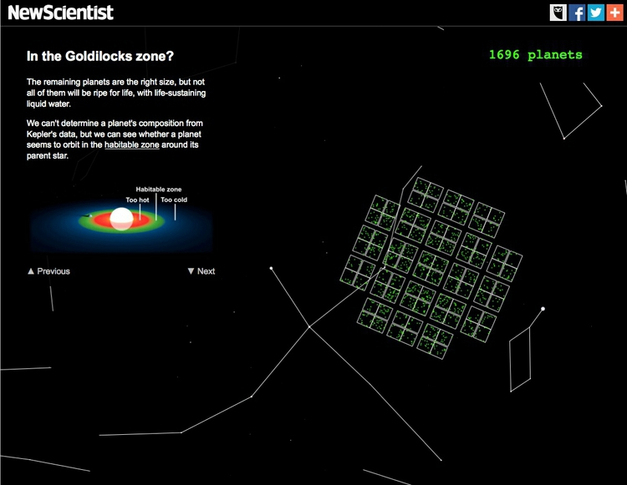
(Source: New Scientist)

Slide 35
‘Mobile-first’ may change your approach
Increasingly, news content is being viewed on mobile devices with small screens
At the most basic level, this means making graphics “responsive,” so that their size adjusts to screen size. But there is more to effective design for mobile than this.
We have already discussed the value of small multiples, which can be made to reflow for different screen sizes.

Slide 36
This interactive, exploring spending on incarceration by block in Chicago, is a nice example of organizing and displaying the same material differently for different screen sizes. Open it up on your laptop then reduce the size of your browswer window to see how it behaves.

Slide 37
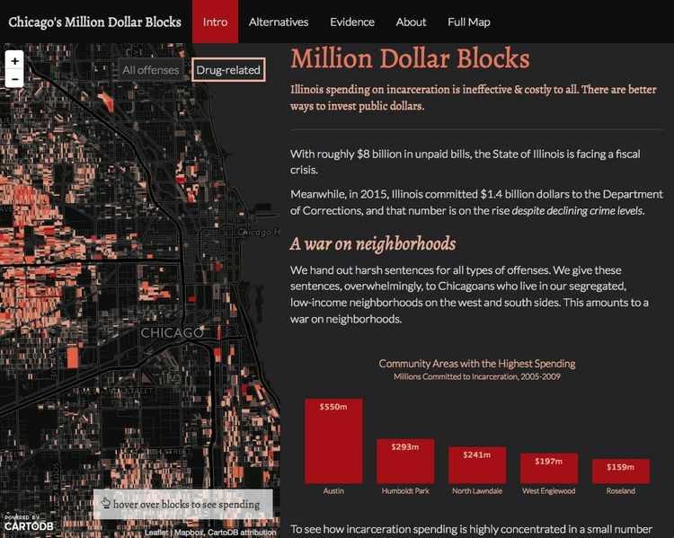
(Source: DataMade)

Slide 38
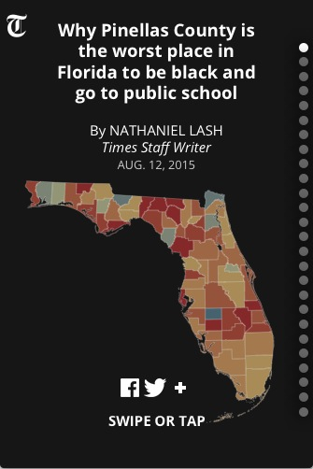
Again, a step-by-step narrative can be a useful device in overcoming the limitations of a small screen. This interactive, exploring school segregation by race in Florida, is a good example of this approach:

Slide 39
Be careful with animation
Animation in interactives can be very effective. But remember the goal of staying true to the ‘feel’ of the data. Animated images evolve over time, so animation can be particularly useful to encode data that changes over time. But again you need to think about what the human brain is able to perceive. Research has shown that people have trouble tracking more than about four points at a time. Try playing Gapminder World without the energetic audio commentary of Hans Rosling’s “200 Countries” video, and see whether the story told by the data is clear.
Animated transitions between different states of a graphic can be pleasing. But overdo it, and you’re into the realm of annoying Powerpoint presentations with items zooming into slides with distracting animation effects. It’s also possible for elegant animated transitions to “steal the show” from the story told by the data, which arguably is the case for this exploration by The New York Times of President Obama’s 2013 budget request to Congress:

Slide 40
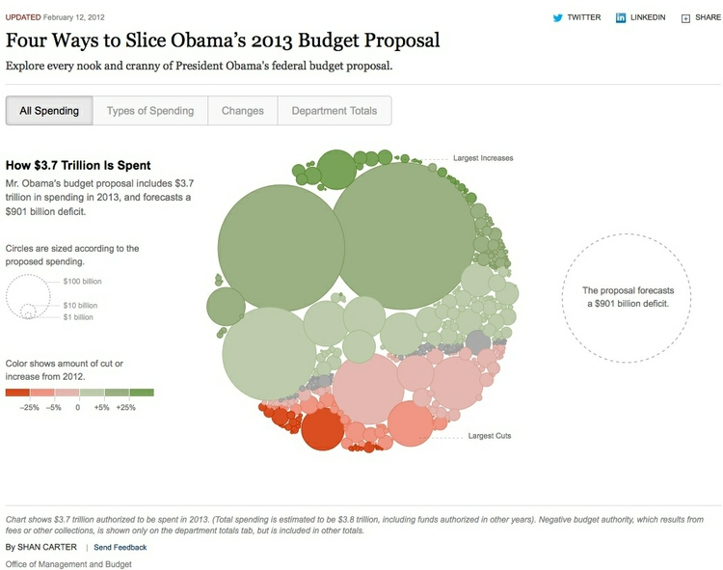
(Source: The New York Times)

Slide 41
Sketch and experiment to find the story
There are many ways of visualizing the same data. Effective graphics and interactives do not usually emerge fully formed.
They usually arise through sketching and experimentation.
As you sketch and experiment with data, use the framework suggested by the chart selector thought-starter to prioritize different chart types, and always keep the perceptual hierarchy of visual cues at the front of your mind.
Remember the mantra: Design for the human brain!
Also, show your experiments to friends and colleagues.
If people are confused or don’t see the story, you may need to try a different approach.

Slide 42
Learn from the experts
Over the coming weeks and beyond, make a habit of looking for innovative graphics, especially those employing unusual chart forms, that communicate the story from data in an effective way.
Work out how they use visual cues to encode data. Here are a couple of examples from The New York Times to get you started.

Slide 43
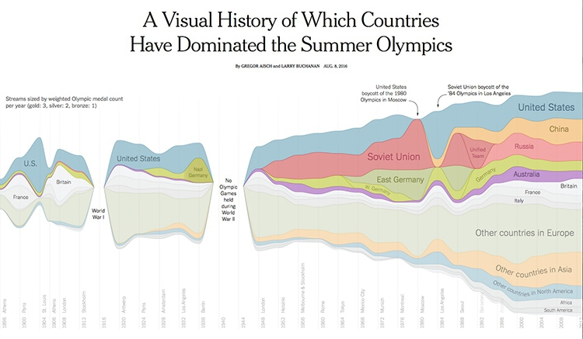
(Source: The New York Times)

Slide 44
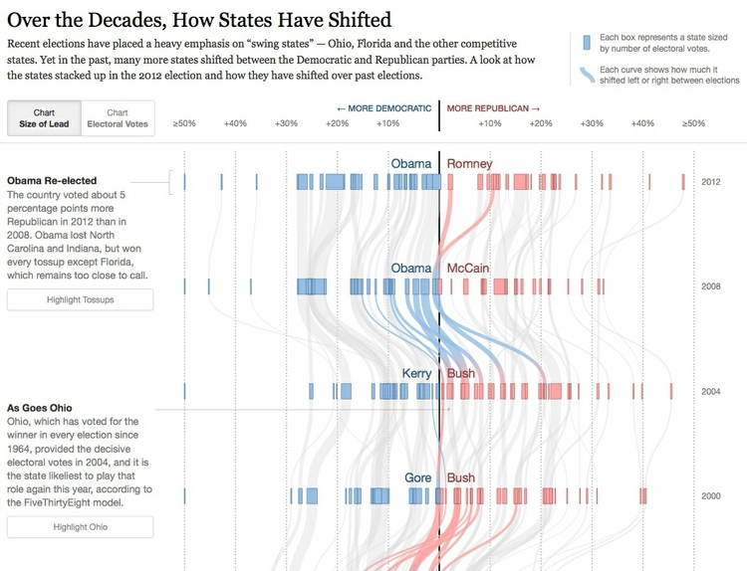
(Source: The New York Times)

Slide 45
Further Reading
Amazon.com: Functional Art, The: An introduction to information graphics and visualization (Voices That Matter): 9780321834737: Cairo, Alberto: Books
Data Points: Visualization That Means Something 1st Edition

Slide 46
Question
?
Notes:
https://paldhous.github.io/ucb/2016/dataviz/week2.html

